Slide 1
United Airlines Case Studies (2025)

Slide 2





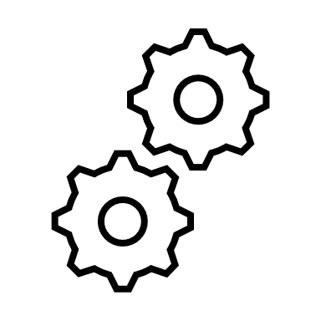
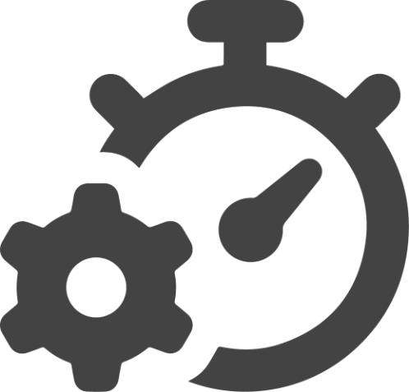

CASE STUDY: Enterprise Architecture Cost Reduction Project
PROBLEM STATEMENT: United Airlines, a global aviation leader, faced escalating egress costs tied to Artifactory, used for deploying applications to AWS. Approximately 70% of these costs stemmed from inefficient retrieval of publicly available third-party images. The reliance on Artifactory led to an estimated $720K in annual unnecessary expenses. A cost-effective solution was needed without disrupting application teams or compromising system reliability.
OBJECTIVES
SOLUTION
IMPACT
PROCESS
DELIVERED
Reduced maintenance and operational overhead associated with Artifactory
Analyzed Artifactory costs, finding 70% stemmed from pulling third-party images through it instead of external repositories
Migrated applications to AWS ECR, reducing reliance on Artifactory and eliminating unnecessary egress costs
Created vanity URLs to streamline the transition and minimize pipeline changes for application teams
Increased ECR quota limits to prevent bottlenecks and ensure seamless performance
Rolled out the solution in development (Dev) and quality assurance (QA) environments before gradually implementing it in production
IMPROVED OPERATIONAL EFFICIENCY
Reduce high egress costs associated with Artifactory usage for deploying applications to AWS services (EKS and ECS)
Assessed AWS ECR as a cost-effective Artifactory alternative, confirming it met United’s business and technical needs
Estimated annual savings of $720,000 by eliminating unnecessary egress costs
$720,000 IN COST SAVINGS
Migrate to a cost-effective AWS-native solution to eliminate unnecessary expenses
Designed an optimized architecture leveraging AWS services such as Route 53, an Application Load Balancer, and AWS ECR
Ensured minimal disruption to application teams through a well-structured migration approach
Developed and tested a phased migration strategy to ensure minimal disruption to application teams
SEAMLESS TRANSITION
Ensure minimal disruption to application development teams during the transition
Migrated approximately 500 applications, enhancing system resilience and efficiency
Maintain system reliability, availability, and security throughout the migration process
IMPROVED SCALABILITY & RELIABILITY
Transitioned from Artifactory to an AWS-native solution using Route 53, Application Load Balancer, AWS ECR, and Lambda for efficient deployment management
SUCCESSFUL TECHNOLOGY ENHANCEMENT

